Slide 1
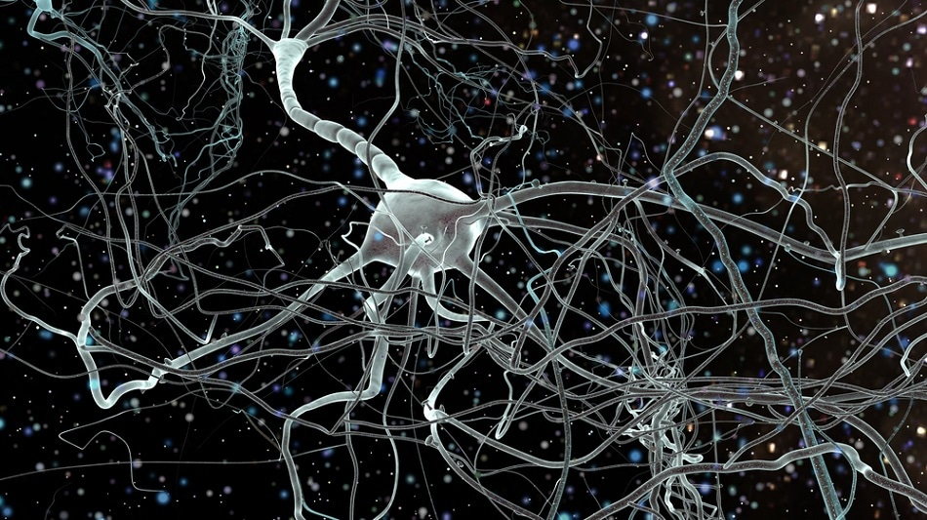
BT5130
Neural Tissue Engineering : Designing constructs for improved emulation
Presented by –
Sahana Gangadharan
04-11-2020

Slide 2
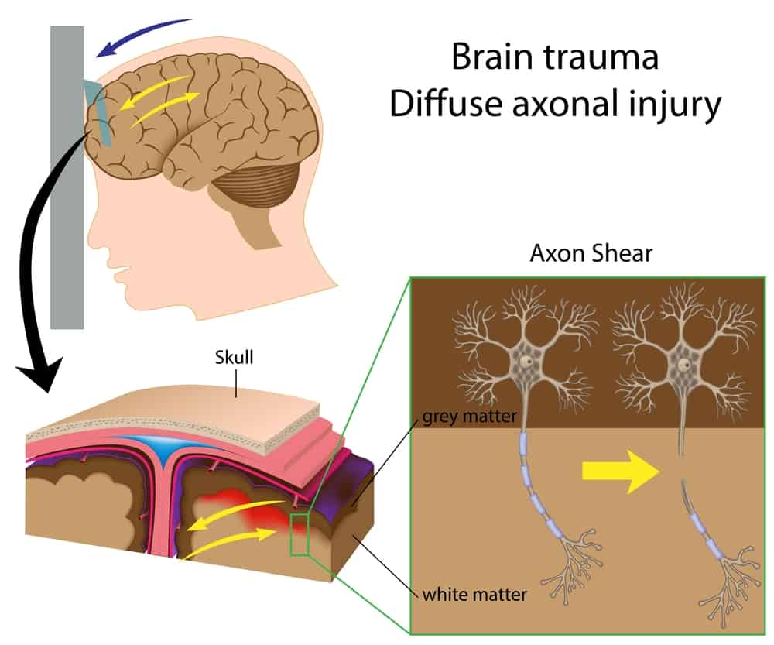
Problem – Injury and its characteristics
Traumatic Brain Injury (TBI).
Diffuse axon injury (DAI).
What happens?
Shearing of axon at the junction of grey-white matter in the prefrontal lobe, corpus callosum, internal capsule and upper brainstem.
Axonal swelling and disconnection.
Source: Propel Physiotherapy

Slide 3
Neural Tissue Engineering for TBI
Challenges -
Inflammation at the site of injury.
Allodynia (increased pain to a stimulus that is otherwise noxious.)
The transplanted tissue/scaffold should adjust well at the site of injury.
Glial scars affects axonal regeneration by producing inhibitory molecules such as CSPGs, tenascin or ephrin-B2.
Avoid secondary cell death, loss of cells during injection.
Required characteristics -
Include anti-inflammatory molecules along with the culture at the site of implantation.
Electrical stimulation to induce differentiation.
In general, avoid adding growth enhancement factors in vivo.
Composition of scaffold similar to the brain tissue at the site of injury.
Increased angiogenesis and reduced astrogliosis.

Slide 4
Scaffolds in Neural Tissue Engineering
Scaffolds –
Hydrogels
Hyaluronic acid, Collagen, Alginate, Laminin.
N-carboxyethyl chitosan (CEC) and oxidized sodium alginate (OSA) -> CEC-l-OSA hydrogels.
Injectable – click-crosslinked hydrogels (well studied in Cartilage TE), pH sensitive hydrogels, thermo-responsive hydrogels
Electrospun scaffolds
PCL/PLGA polymers,
PLLA/collagen.
Spidroin (recombinant spider silk protein)

Slide 5
Cells and their Differentiating Factors in NTE
Cells –
Mesenchymal stem cells – BM-MSCs, AT-MSCs
…MSCs were cultured in D-MEM (Invitrogen) without serum to induce the expression of Nestin.
Umbilical Cord MSCs – Edaravone and Resveratrol.
Embryonic stem cells and iPSCs.
…include the development of an ES cell line modified with an inducible suicide gene expressed under a promoter element used to maintain ‘stemness’ and the use of targeted anti-human ES cell antibodies that induce apoptosis in undifferentiated ES cells.
Nerve Stem Cells (NSCs) + Neurotrophic factors in Neurobasal medium (Invitrogen).
Differentiating factors –
Neurotrophic factors such as Neurotrophin-3 (NT3), Nerve Growth Factor (NGF), Leukemia inhibitory factor (LIF) variety of miRNAs, Sovateltide (IRL-1620), erythropoietin (EPO) and granulocyte colony-stimulating factor (G-CSF), retinoic acid, recombinant human bFGF, and many more.

Slide 6
Proposed solution
Culture human Umbilical cord mesenchymal stem cells (hUMSCs) on a spidroin matrix (4RepCT) in a neurobasal medium.
Add neurotrophic factors essential for growth.
Electrically stimulate the cells for controlled differentiation.
Post 7 days of in vitro culture (i.e., when the fate is guided towards neurons), seed the cells onto Hyaluronic acid + Laminin based hydrogel (which mimics prefrontal lobe almost exactly).
Transplantation –
Anesthetize the model organism (mice?) and perform a surgery (midline incision) and place the scaffold.
Inject the hydrogel through the caudal (tail) vein – in situ crosslinking in brain? Size of the scaffold?
Analysis –
Assess the functions of prefrontal lobe (decision making & moderating social behaviour) by conducting appropriate tests.
Histological analysis – sacrifice the mouse -> extract brain tissue and observe expression of Nestin, NCAM, NSE.
Isolate RNA, perform RNA sequencing and identify the genes that are upregulated/downregulated.

Slide 7
Summary
Neural Tissue Engineering
Scaffolds and Constructs
Different cells and their differentiating factors
Scaffolds
Cells and Factors
Umbilical cord-derived
Hydrogel systems
Laminin
Injectable hydrogel
Electrospun scaffolds
Collagen
PCL/PLGA
Spidroin
Mesenchymal cells
Bone marrow-derived
Adipose tissue-derived
Embryonic stem cells and Induced Pluripotent stem cells
Hyaluronic acid
FDA-approved constructs
NeuraGen, Neurolac, NeuroWrap, and many more
Challenges with TBI
Brain is very sensitive and neurons show very poor regenerative ability
Shearing of axon at the junction of grey-white matter in the prefrontal lobe.
Axonal swelling and disconnection.
Collagen

